Slide 1

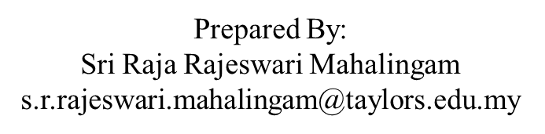
APPLICATION CHEMISTRY
A2 LEVEL
BIOCHEMISTRY
CHAPTER 1: PROTEINS

Slide 2
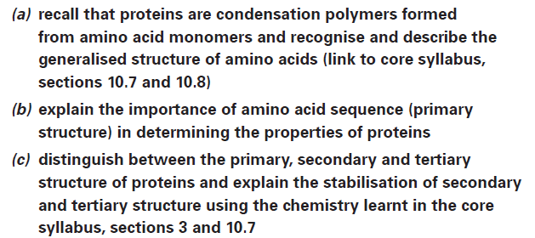
What you should know…

Slide 3
Proteins
Antibodies, enzymes and haemoglobin, are water-soluble molecules.
Collagen and keratin, are insoluble and aggregate to form very tough and resistant structures.
Proteins make up 18% of the mass of the average person.
Proteins are unbranched polymer chains made by linking together large numbers (from hundreds to several thousand) of amino acid monomer units by peptide bonds.
Such chains are often referred to as polypeptide chains.

Slide 4
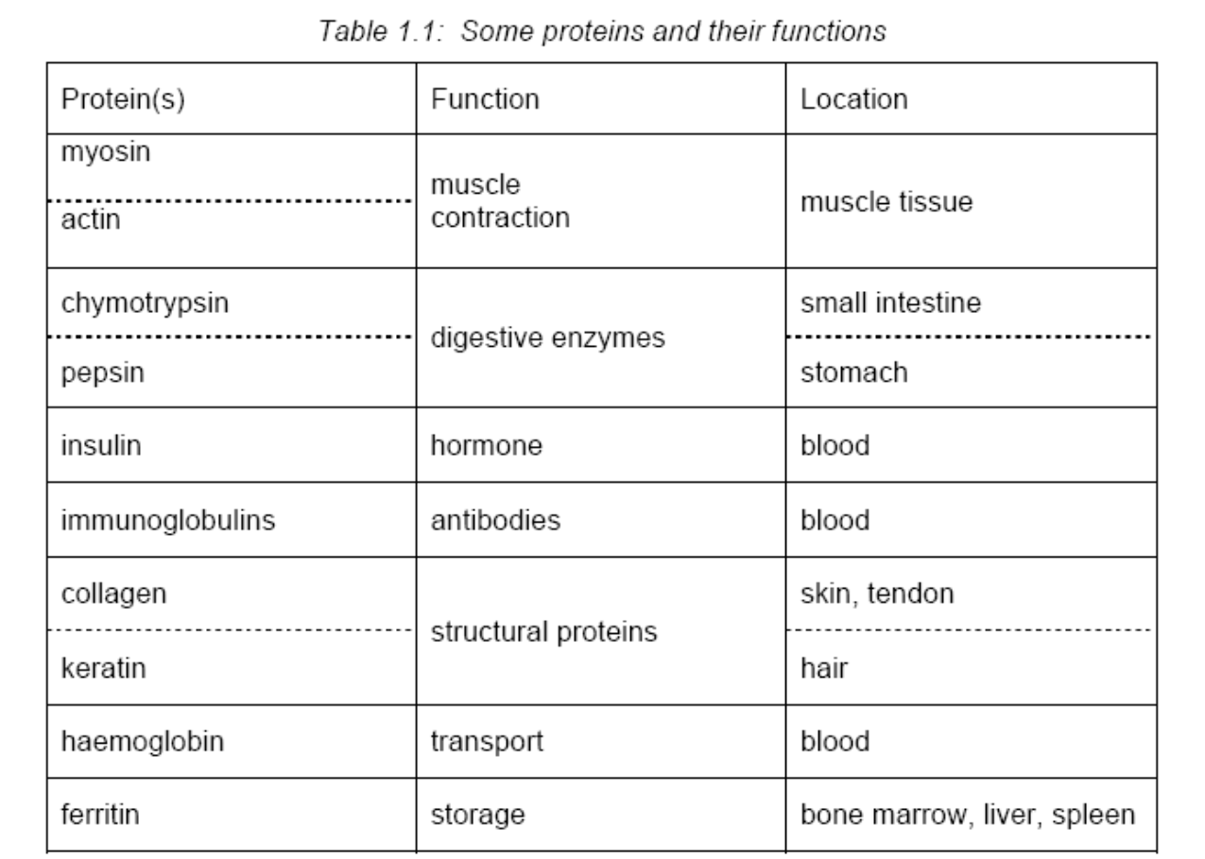
Proteins

Slide 5
Amino Acids
Protein chains are synthesized from twenty different amino acids.
Nineteen of these molecules contain two functional groups: a carboxylic acid group ( -COOH ) and a primary amino group ( -NH₂).
All have one common feature: the two functional groups are both attached to the same carbon atom

Slide 6
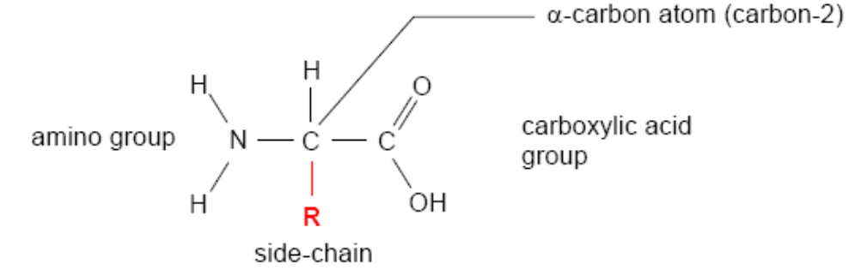
Amino Acids
The carbon atom of an acid group is always counted as the first in the structure
Amino group is always attached to the second carbon atom (C-2)
This carbon atom is also sometimes known as the α-carbon atom
These important molecules are therefore all 2-amino acids (or α-amino acids).

Slide 7
Amino Acids
The 20 different amino acids that cells use to build proteins differ in the nature of the R-group
Simplest, where R is hydrogen atom –
2-aminoethanoic acid (glycine)
The 20 different amino acids can usefully be categorized into separate sub-groups according to the nature of the R-group
There are three broad categories depending on whether the side-chain group is non-polar, polar, or can be ionised (charged) under appropriate conditions

Slide 8
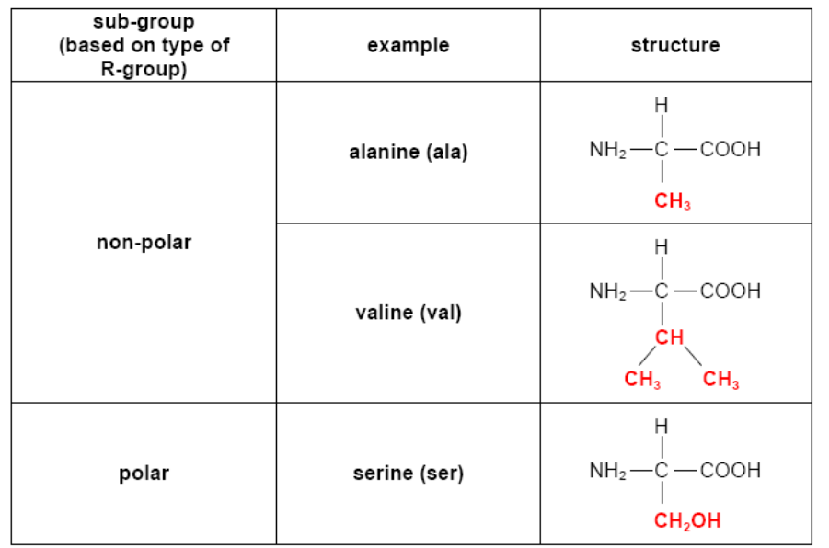
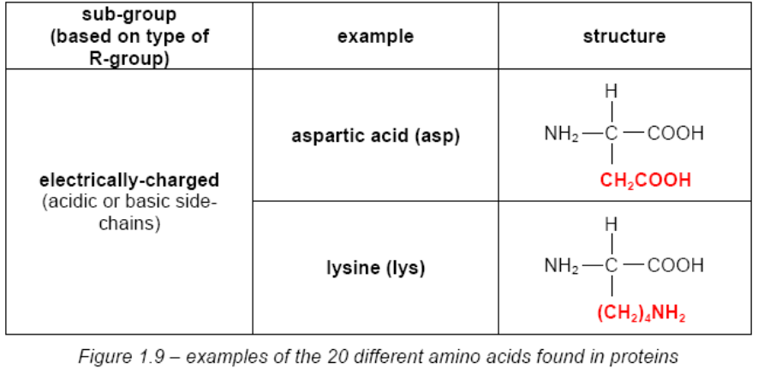

Slide 9
Amino Acids
The nature of the R-groups in these amino acids is of crucial importance.
Once the amino acids have condensed together to form a polypeptide chain, the R-group is the remaining feature of a particular amino acid which is still distinctive.
Interactions between the different R-groups profoundly influence the folding of the polypeptide chain, and hence the shape of the final protein

Slide 10
Ionisation of Amino Acids
Amino acid molecule – amphoteric
X-ray crystallography of crystalline amino acids has shown that amino acids exist in the zwitterionic form in the solid.
Physical properties characteristic of ionic compounds: white solids that are soluble in water.

Slide 11
Ionisation of Amino Acids
Amino acids such as glycine or alanine, with non-polar R-groups, will have no net charge at pH 7 (overall charge = 0)
Aspartic acid will have an overall charge of –1 because of the additional acid group in its side-chain.
These differences in charge can be used to separate amino acids by electrophoresis or ion exchange chromatography.

Slide 12
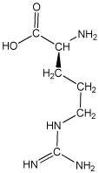
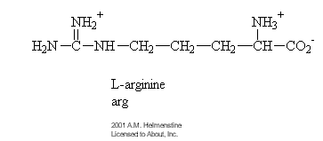
Ionisation of Amino Acids
Arginine structure

Slide 13
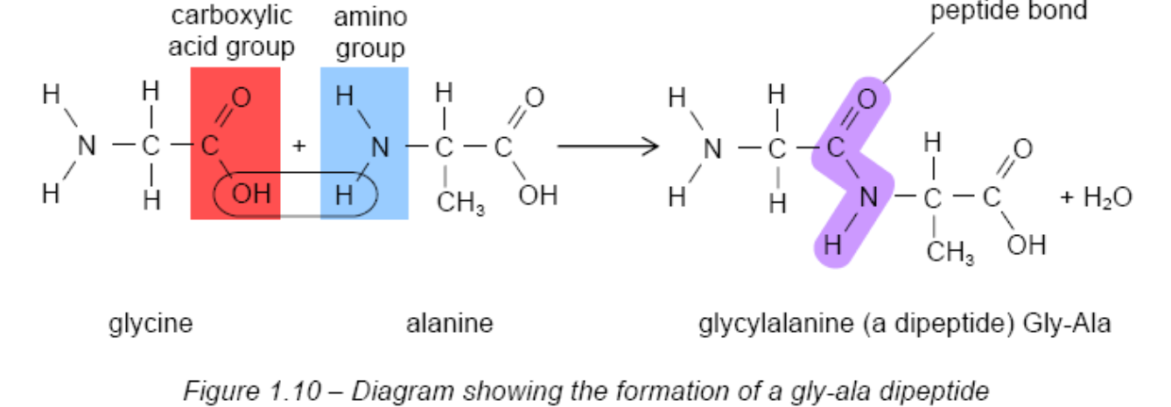
Structure
Condensation Polymerisation of amino acids
When many amino acids react to form a polymer they produce a condensation polymer – a protein (or polypeptide chain).
Additional amino acids can react with the dipeptide to form first a tripeptide and then eventually a polypeptide. In this way a protein can be put together.

Slide 14
Structure
Condensation Polymerisation of amino acids
The peptide bond consists of the group –CONH- in which the four atoms lie in one plane, with all bond angles being about 120°.
Each protein chain is a linear polymer built from its own unique selection from the amino acid pool.
The sequence is genetically determined and characterizes that particular protein.

Slide 15
Structure
Condensation Polymerisation of amino acids
The structure of a single protein chain in its functional form can be considered on three levels:
• Primary structure – the sequence of amino acids in a polypeptide chain – the direct product of the coding sequence in the gene.;
• Secondary structure – regular structural arrangements of the polypeptide chain that result from hydrogen-bonding between peptide bond regions of the chain;
• Tertiary structure – the overall folding of a polypeptide chain that arises from interactions between the amino acid side-chains.

Slide 16
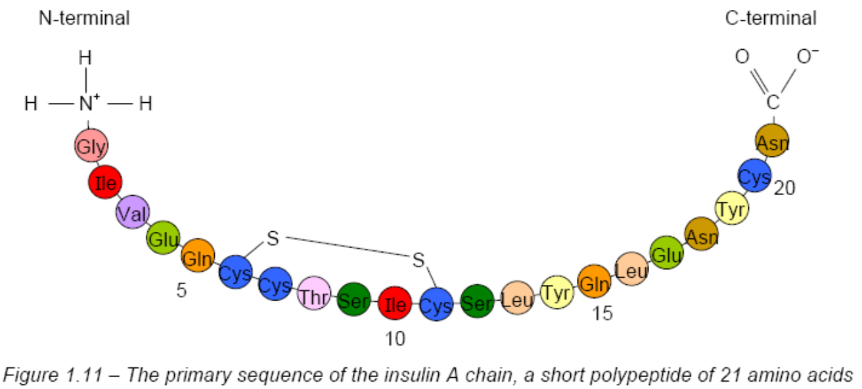
Primary Structure
Each polypeptide chain is a linear polymer of amino acids and as such has an amino- (or N-) terminal end and a carboxy- (or C-)terminal end

Slide 17
Primary Structure
Each polypeptide has direction and the sequence of amino acid residues in a chain is known as the primary structure of the polypeptide.
In the cell, a polypeptide chain is always synthesized from the N-terminal end to the C-terminal end.
when writing out the primary sequence of a polypeptide chain the amino acids are numbered from the N-terminal end.
Primary structure of a polypeptide chain is genetically controlled

Slide 18
Secondary Structure
Each polypeptide has a ‘backbone’
This backbone is essentially the same for all protein chains [ -C-C-N-C-C-N- etc].
Polypeptide backbone is flexible and in certain regions of the protein can fold in a regular manner, known as secondary structure.
These structures are stabilized by hydrogen bonding between the peptide bond regions of the chain’s backbone (Figure 1.12)

Slide 19
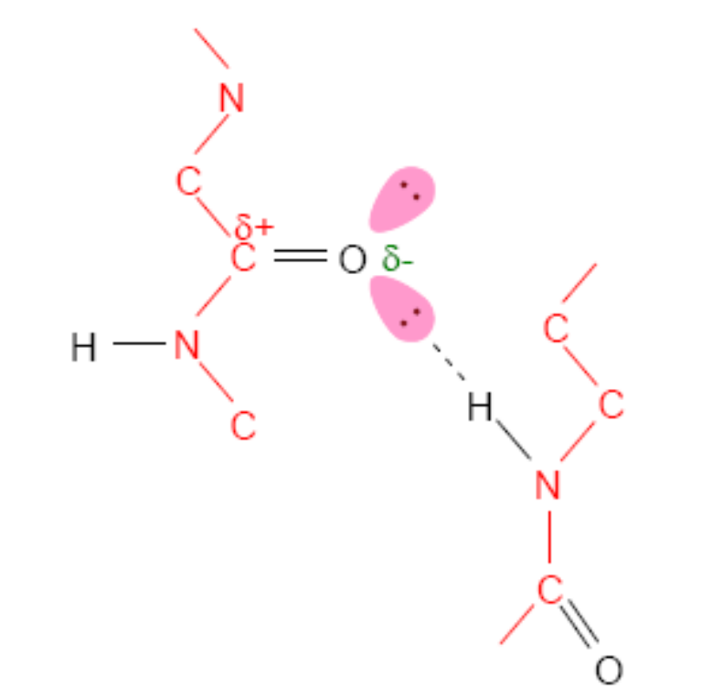
Secondary Structure
Collectively this level of structural organisation is known as secondary structure.
Illustration of hydrogen bond between two peptide link regions

Slide 20
Secondary Structure
Two of the most stable arrangements at this level of protein folding are the α-helix and the β-pleated sheet.
In both these structures the chain folds on itself in a very stable arrangement because of the many hydrogen bonds formed between adjacent peptide bond regions.

Slide 21
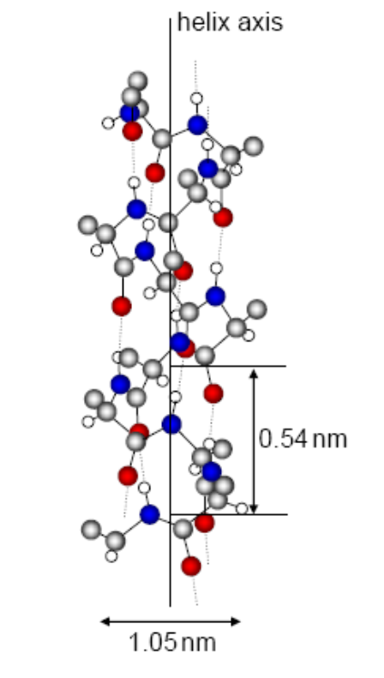
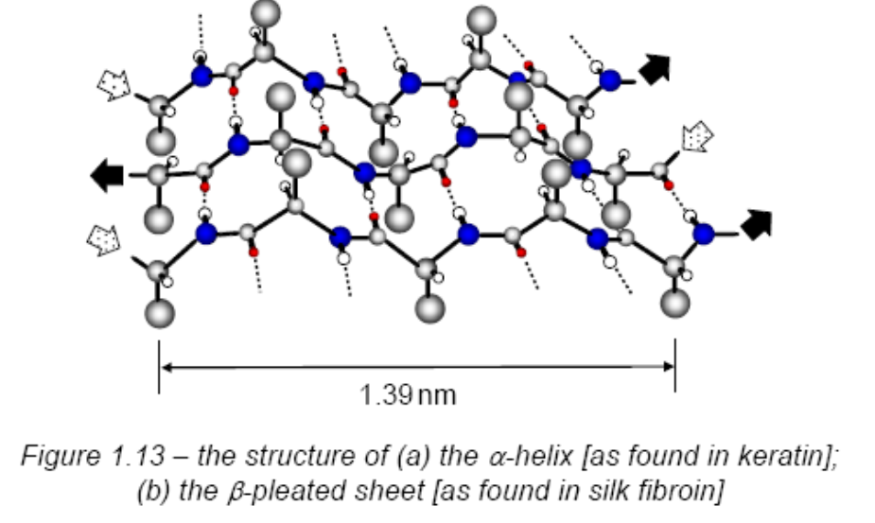
Secondary Structure
The structure has distinct α-helical regions, represented by the ‘cylindrical rods’, and β-pleated sheet regions, represented by the ‘arrows’.

Slide 22
Tertiary Structure
Interactions between the R-groups of the different amino acid residues in a protein chain
The three-dimensional shape or conformation of a protein chain is maintained by a series of mainly non-covalent, intramolecular interactions between the R-groups of the amino acids making the chain.
The chemical nature of the different R-groups (see Figure 1.9 earlier) becomes particularly significant.

Slide 23
Tertiary Structure
Some of these interactions are relatively easily disrupted, others not so, and include:
• van der Waals’ forces between non-polar side-chains,
• hydrogen bonding between polar R-groups,
• ionic bonds (salt bridges) between ionised R-groups, and
• covalent disulphide bridges formed between cysteine residues at different locations in the primary sequence (Figure 1.15)

Slide 24
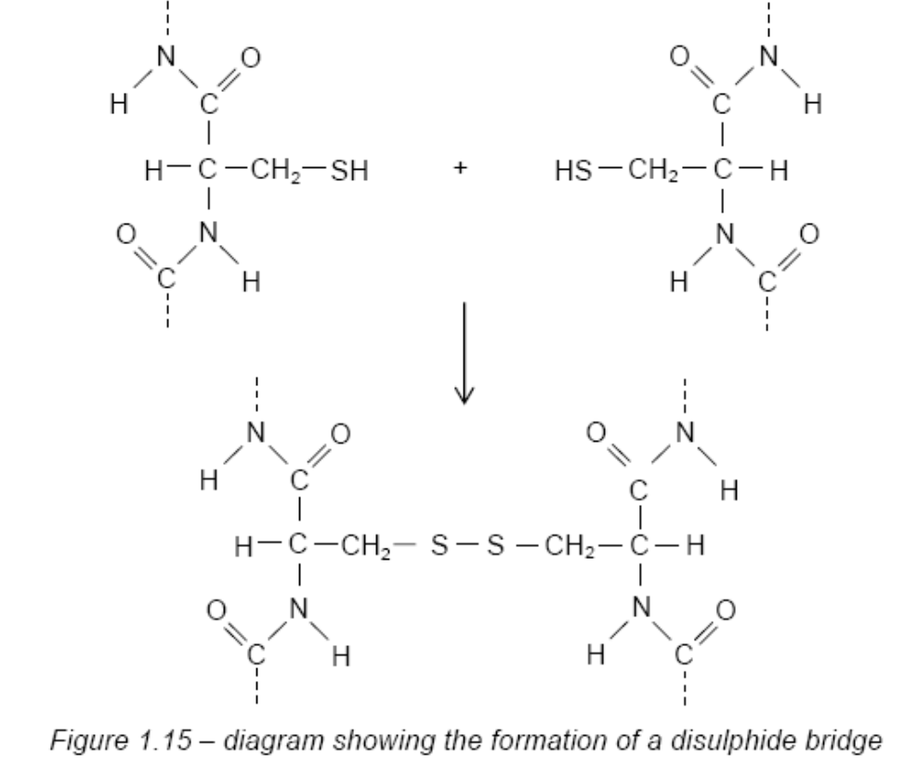
Tertiary Structure
Because of their covalent nature disulphide bonds can have the effect of locking a particular tertiary structure in place.

Slide 25
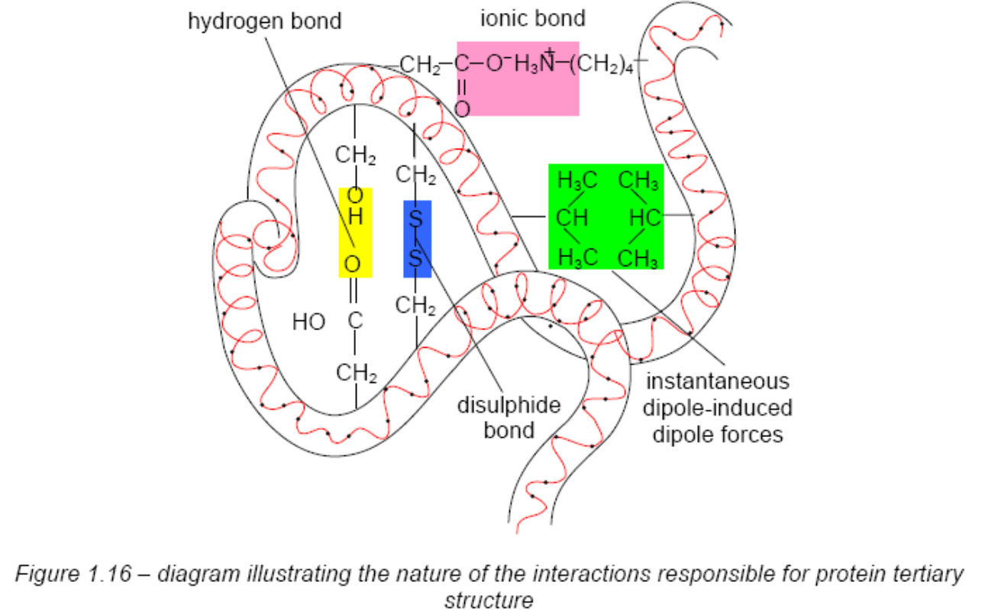
Tertiary Structure

Slide 26
Quaternary structure
Haemoglobin
Proteins with 2 or more separate polypeptide chains exhibit this structure.
Consists of two pairs of identical protein chains (subunits) known as α- and β-chains.
These assemble together to form the functional, oxygen-carrying protein in our red blood cells (Figure 1.17).
The human globin α- and β-chains are different polypeptide chains coded for by different genes.
When folded, each of the globin chains has a high degree (about 70%) of α-helical secondary structure.

Slide 27
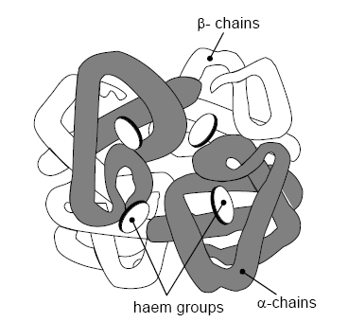
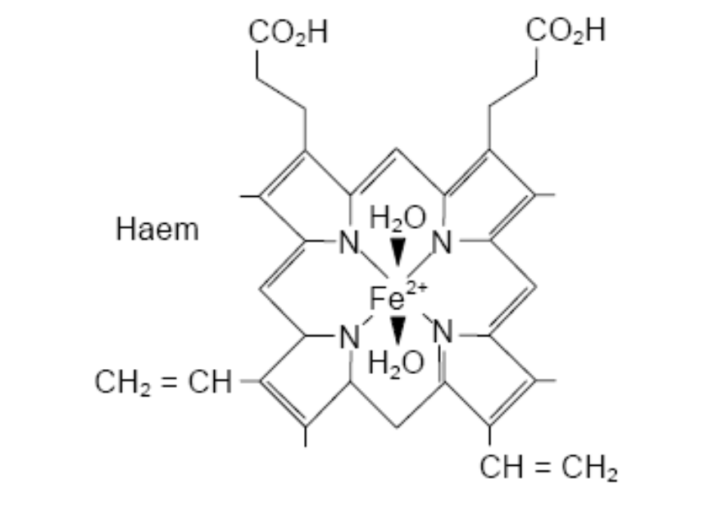
Quaternary structure
Haemoglobin

Slide 28
Quaternary structure
Haemoglobin
Each of the protein subunits in one molecule is also bound to a non-protein haem group containing an iron(II) ion (Fe²⁺).
The iron(II) ions in the haem groups bind oxygen and enable the molecules to perform their function of transporting oxygen around the body.
The non-covalent interactions similar to those involved in tertiary structure bind these haem groups in place in the structure.

Slide 29
Quaternary structure
Haemoglobin
Overall structure of the whole molecule changes as oxygen binds to the haem groups.
There is a favoured sequence for the attachment and detachment of oxygen from the molecule.
Either all four subunits have oxygen attached to their haem groups, or none of them do.

